Slide 1
Setting Print Options
In Excel 2007

Slide 2
Preparing a Worksheet for Printing
Views:
Normal View (when entering and formatting data in a worksheet
Page Layout view (when you prepare a worksheet to print).

Slide 3
Setting Margins:
Margins are the blank spaces around the top, bottom, and sides of a page
Page Layout Tab, Page Setup Group, click the Margins button

Slide 4
Changing the Page Orientation
Portrait: longer than wide
Landscape: Wider than long
Page Layout Tab/Page Setup Group

Slide 5
Printing Options in the Page Setup Dialog Box
Fit to one page

Slide 6
Page Breaks
Page Layout Tab, Insert Page Break OR Page Break Preview (automatic page breaks are dotted, manual page breaks are solid lines)
Automatic Page Breaks
When Excel runs out of room
Manual Page Breaks
Inserted manually to start a new page

Slide 7
Scaling to Fit
Scaling allows you to resize a worksheet to print on a specific number of pages
Page Layout Tab
Scale to Fit Group
Three options

Slide 8
Choosing Sheet Options
By default, gridlines, row numbers, and column letters appear in the worksheet but do not appear on the printed page.

Slide 9
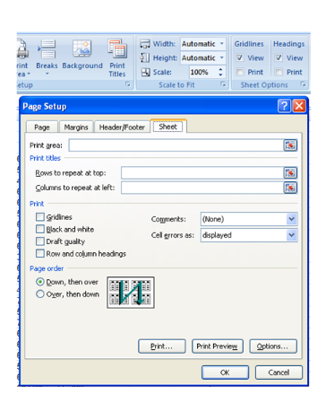
Specifying Print Titles
Print titles are designated rows and/or columns in a worksheet that print on each page.

Slide 10
Headers and Footers
HOW: Insert Tab, text group, click header & footer button
IMPORTANT:
The worksheet switches to the page layout view - click anywhere in the worksheet to exit header and footer then click on the Normal view button to get out of Page Layout view

